Slide 1
Online Truck Transportation System
Mr. Mohammad Haneef (219105)
Mr. Abhishek Dhadge (219007)

Slide 2
Introduction
ONLINE TRUCK TRANSPORTATION SYSTEM (TRS) is a web-based system for a truck owner and customer that book truck service. This system enables the truck owner to make their services available to the public through the internet and also keep records about their services.
It is a system design especially for large, premium and small Truck Transportation system. The truck transportation system provides complete functionality of listing and booking trucks and creating orders for certain destinations.

Slide 3
Scope
This system allows the Customer can easily get the Truck whenever they need the items to be delivered and the truck owner can also see the orders available for desired destinations which he wants to transport with use of this system.
The system able to provide the better services to their users from time-to-time.

Slide 4
Technology
We used Java Spring-Boot as backend and React JS as Frontend in our Project.
Spring-Boot : The main goal of the Spring Boot framework is to reduce overall development time and increase efficiency. React has become the first choice for frontend because it gives developers the ability to work with a virtual browser (more friendly than the real browser). Also, a JavaScript developer can become a productive developer in a few hours because there is a small API to learn, a few functions, and how to use them…
React : React allows developers to create large web applications that can change data, without reloading the page. The main purpose of React is to be fast, scalable, and simple.

Slide 5
Modules
System
Customer
Truckowner

Slide 6
Customer
Customer can create order, manage booking of available trucks and rent them and also view trucks as well as available orders.
Customer
Register
Login
Create Order
View Order
Update Order
View Truck
Logout

Slide 7
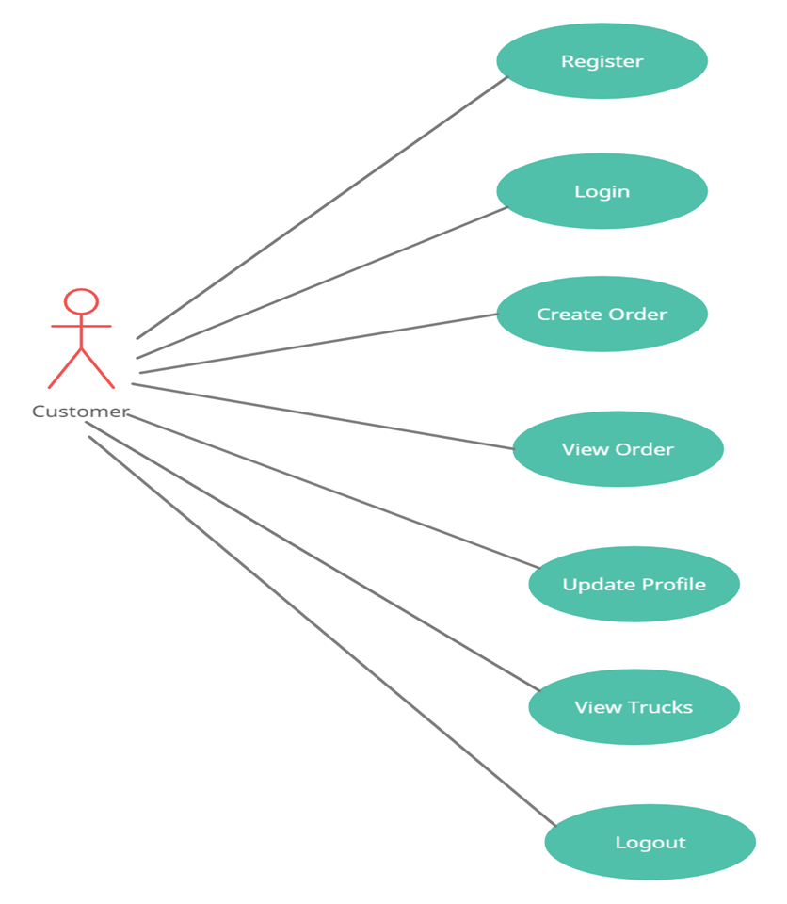
Use Case Diagram for Customer

Slide 8
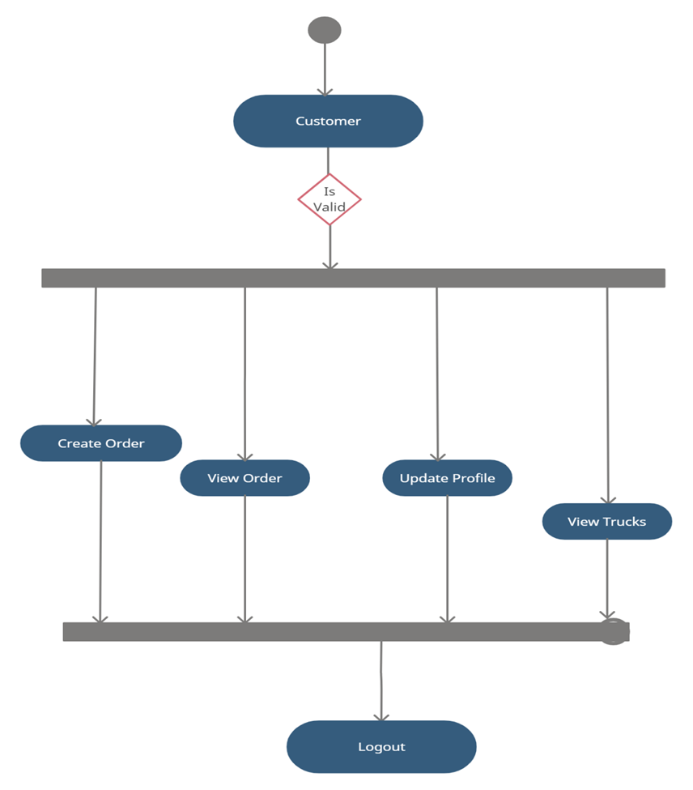
Activity Diagram Customer

Slide 9
Truck Owner
Truck owner can register himself with his vehicle no. and view information of available orders for the locations and easily get the orders.
Truck Owner
Register
Login
View Order
View Truck
Logout

Slide 10
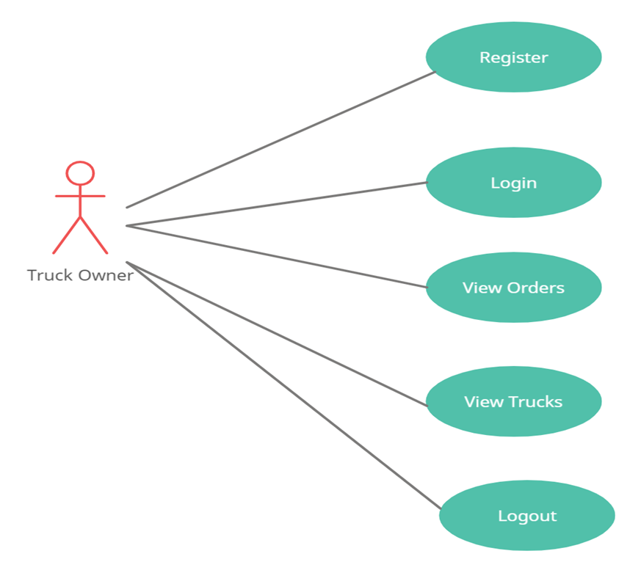
Use Case Diagram For Truck Owner

Slide 11
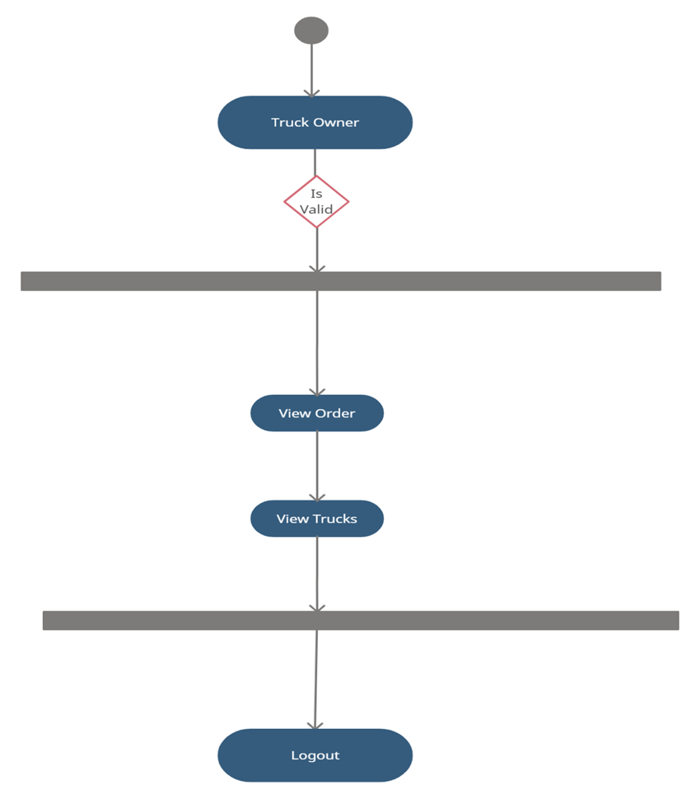
Activity Diagram Truck Owner

Slide 12
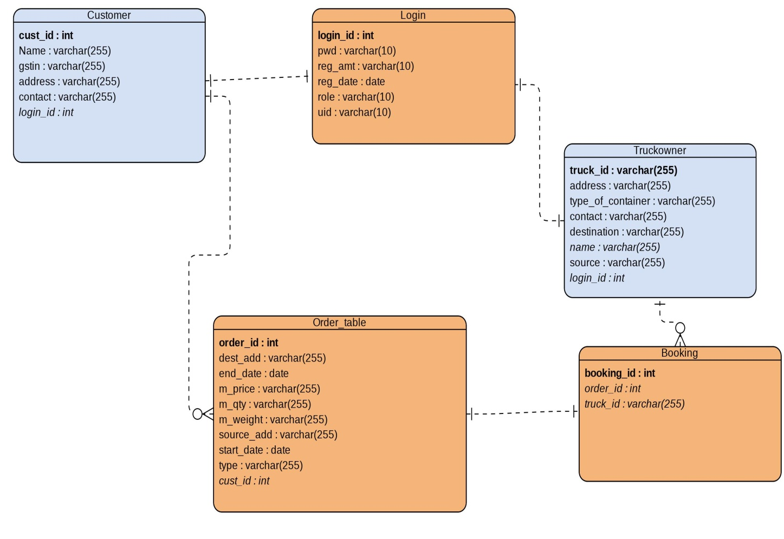
E-R Diagram

Slide 13
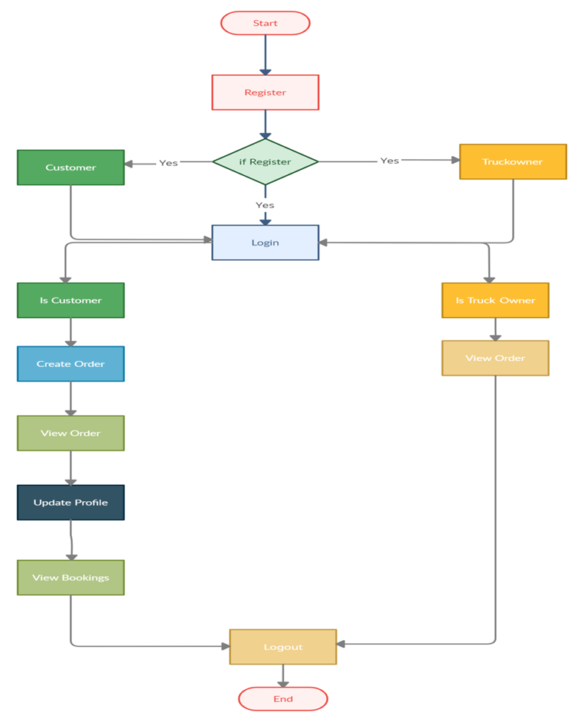
System Flow

Slide 14
Customer Registration
Sr. | Field Name | Data type(Size) | Constraints | Description
1. | Cust_id | int | Primary key | It is store customer id
2. | address | Varchar(255) | Null | It is store address of User
3. | contact | Varchar(255) | null | It is store contact of customer
 | conta
4. | Gstin | Varchar(255) | null | It is store gstno
5. | name | Varchar(255) | null | It is store full name of customer
 |  |  | null
6. | Login_id | int | Foreign key | It is store login id

Slide 15
Booking Table
Sr. | Field Name | Data type (Size) | Constraints | Description
1 | booking_id (Primary) | int(11) | Primary Key | It is used to store booking id
2 | order_id | Int | Foreign key | It is used to store order id of customer
3 | truck_id | varchar(10) | Foreign key | It is used to store truck id of truck owner

Slide 16
Loging Table
Sr. | Field Name | Data type(Size) | Constraints | Description
1 | id (Primary) | int | Primary Key | It is used to store login id
2 | pwd | varchar(45) | Null | It is used to store User password
3 | Reg_amt | varchar(45) | Null | It is used to store registration amount of User
4 | Reg_date | date | Null | It is used to store registration date
5 | role | varchar(10) | Null | It is used to store role
6 | uid | varchar (10) | Null | It is store user id

Slide 17
Truck Owner Table
S.No | Field Name | Data type(Size) | Constraints | Description
1. | Truck_no | Varchar(255) | Primary key | It is used to store truck no
2. | address | Varchar(255) | Null | It is used to store address.
3. | Availability_status | Varchar(255) | Null | It is used to store availability status
4. | contact | Varchar(255) | Null | It is used to store contact no.
5. | destination | Varchar(255) | Null | It is used to store destination.
6. | Name | Varchar(255) | Null | It is used to store name.
7. | Source | Varchar(255) | Null | It is used to store source.
8. | Login_id | int | Foreign key | It is used to store login id.

Slide 18
Order Table
Sr. | Field Name | Data type(Size) | Constraints | Description
No
1 | Order_id (Primary) | int | Primary Key | It is used to store order id
2 | Dest_add | varchar(45) | Null | It is used to store destination address of User
3 | End_date | varchar(45) | Null | It is used to store end date
4 | M_price | varchar(40) | Null | It is used to store material price
5 | M_qty | varchar(40) | Null | It is used to store material quantity
6 | Source_add | varchar(40) | Null | It is used to store source address
7 | Start_Date | Date | Null | It is used to store start date
8 | Status | Varchar(40) | Null | It is Used To Store Status
9 | Cust_id | Int | Foreign Key | It is used to store Customer id

Slide 19
SCREENSHOTS

Slide 20
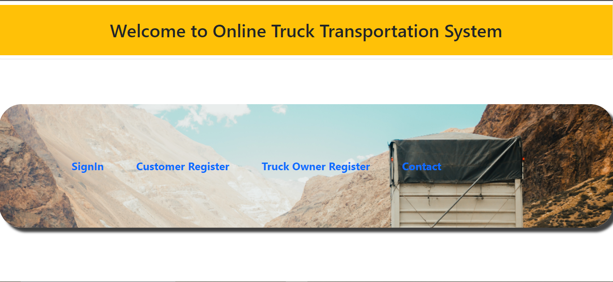

Slide 21
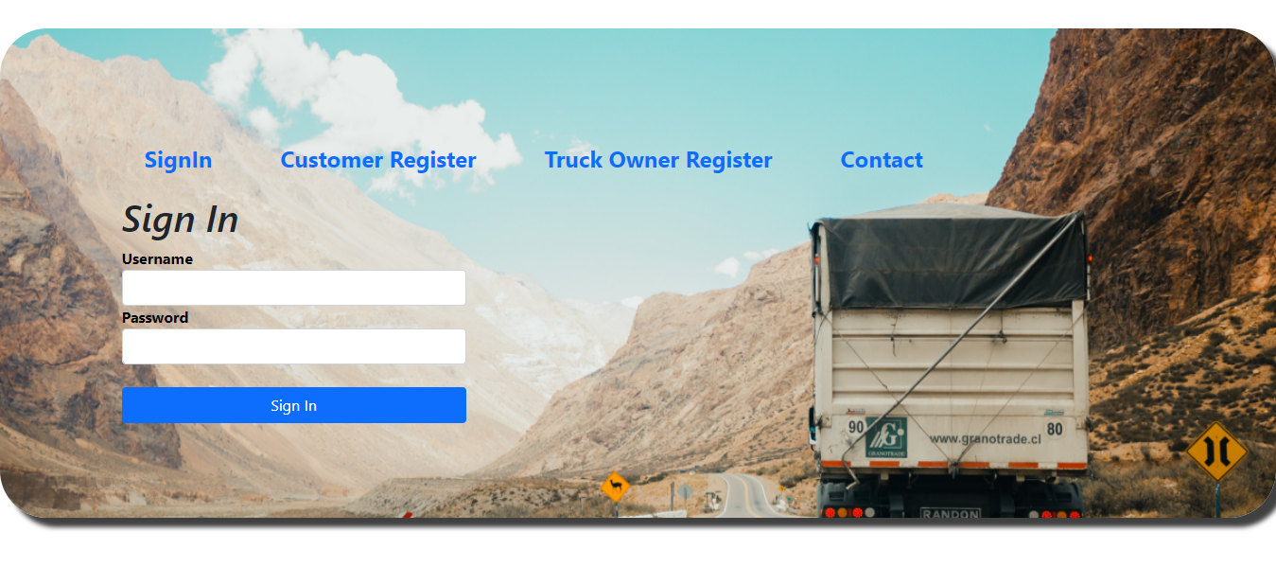

Slide 22
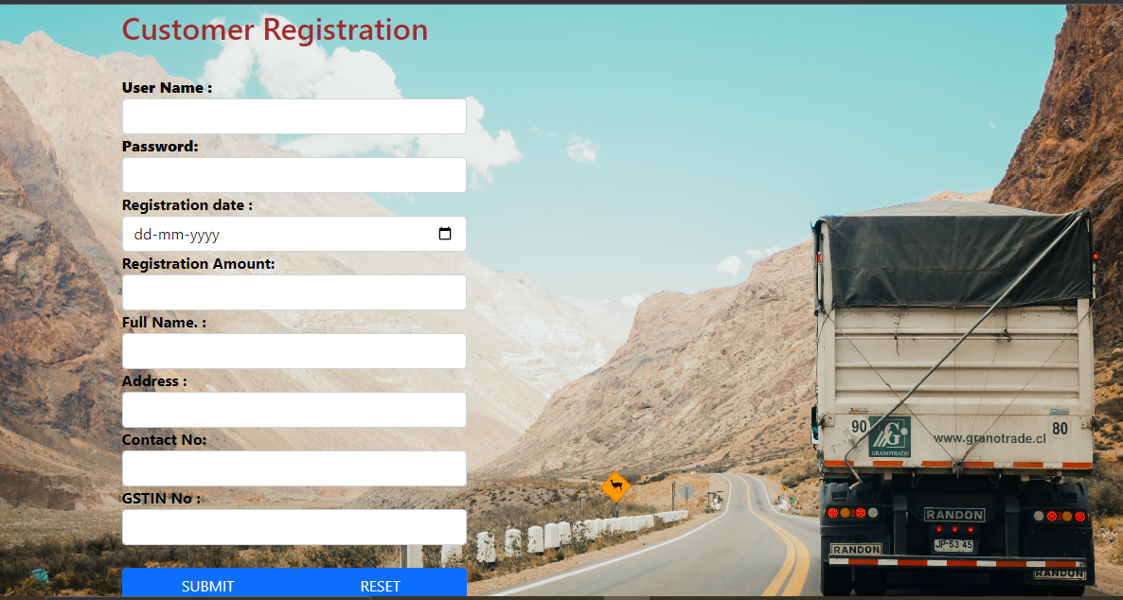

Slide 23
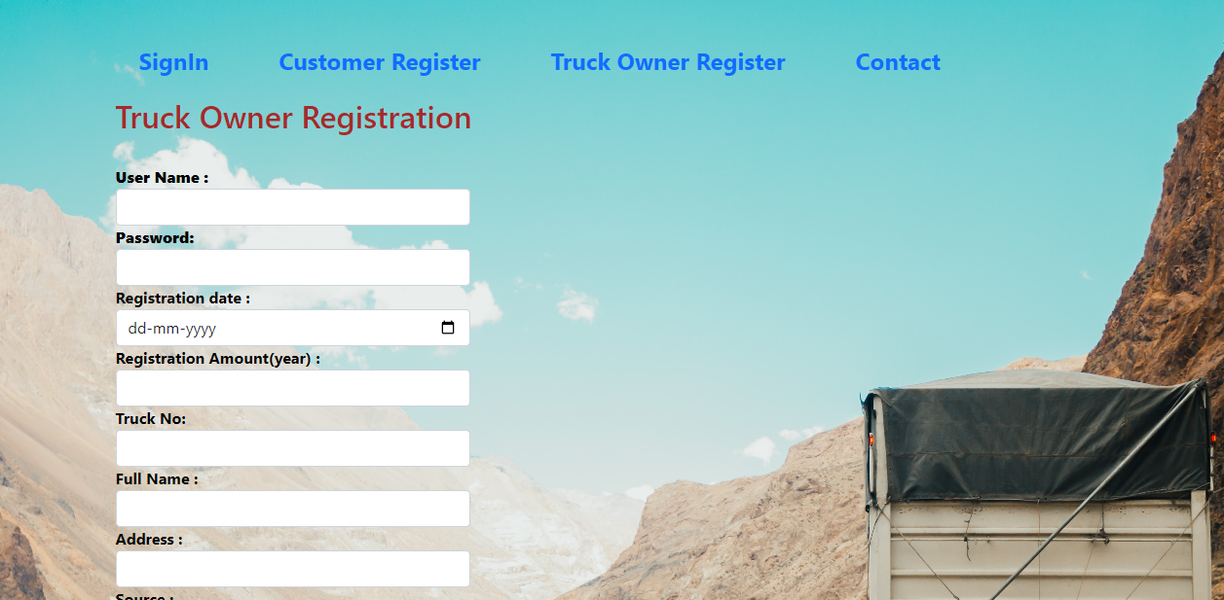

Slide 24
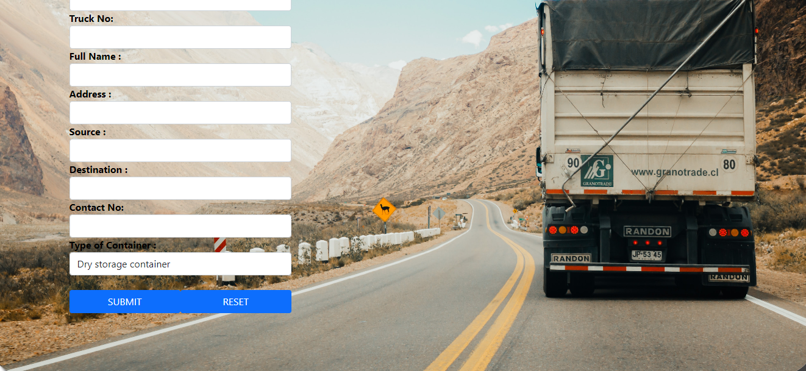

Slide 25
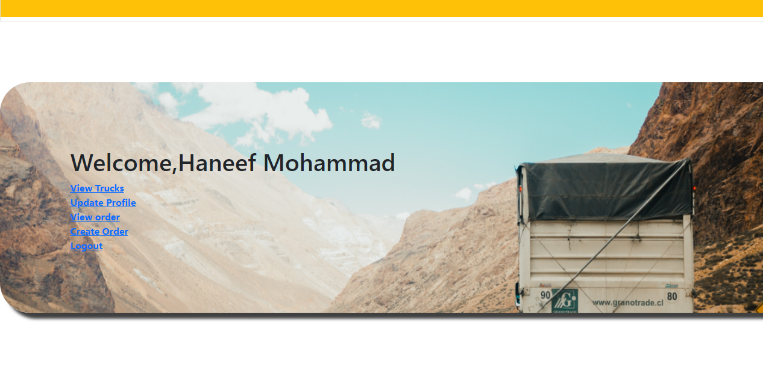

Slide 26
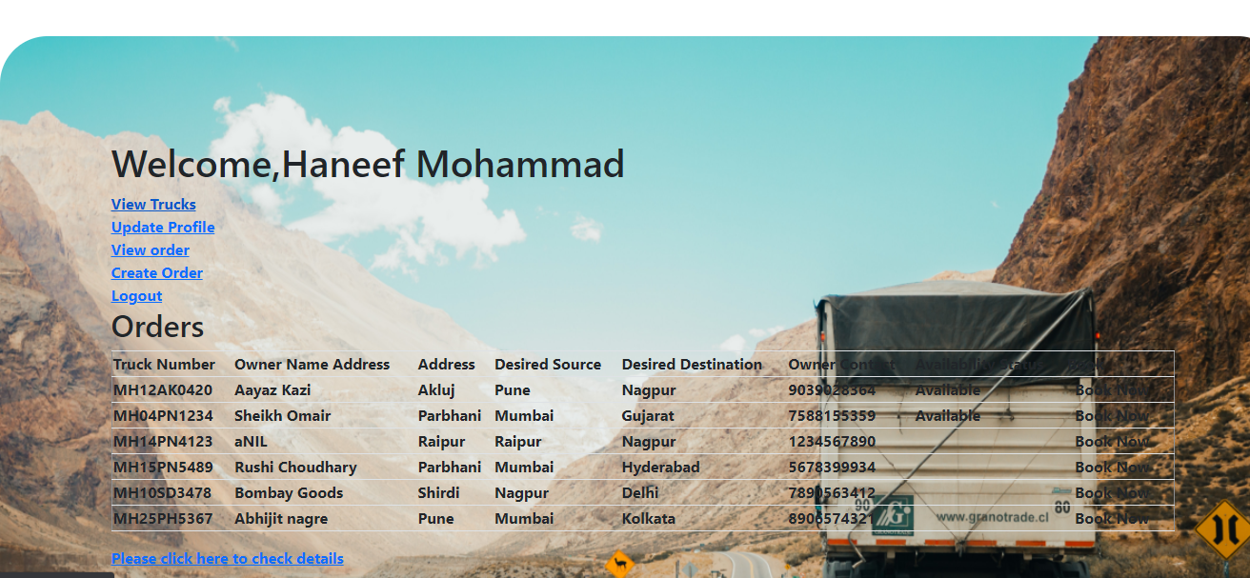

Slide 27
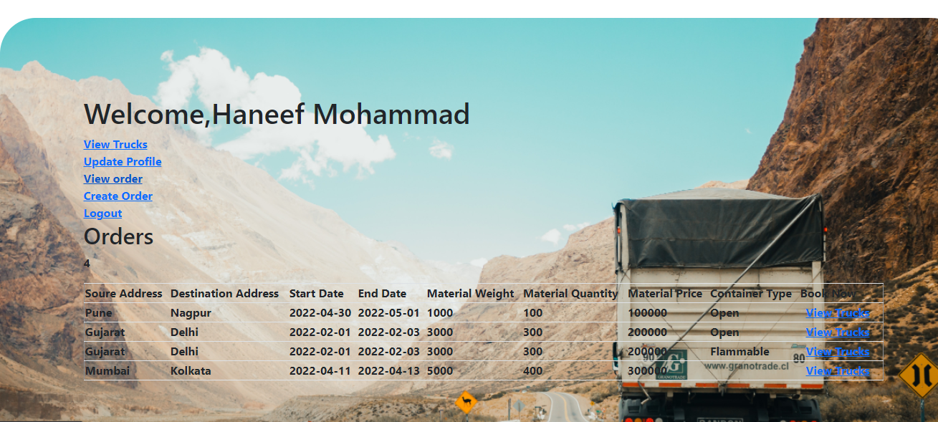

Slide 28
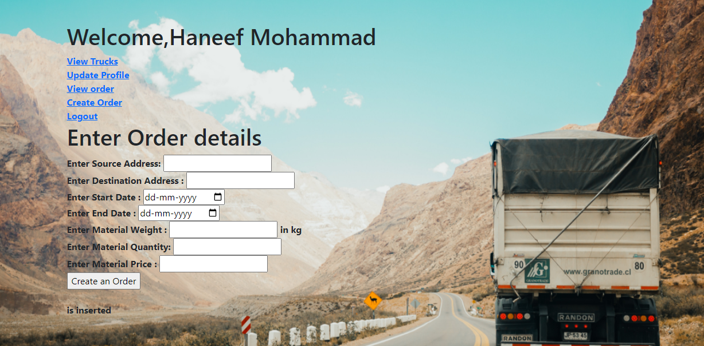

Slide 29
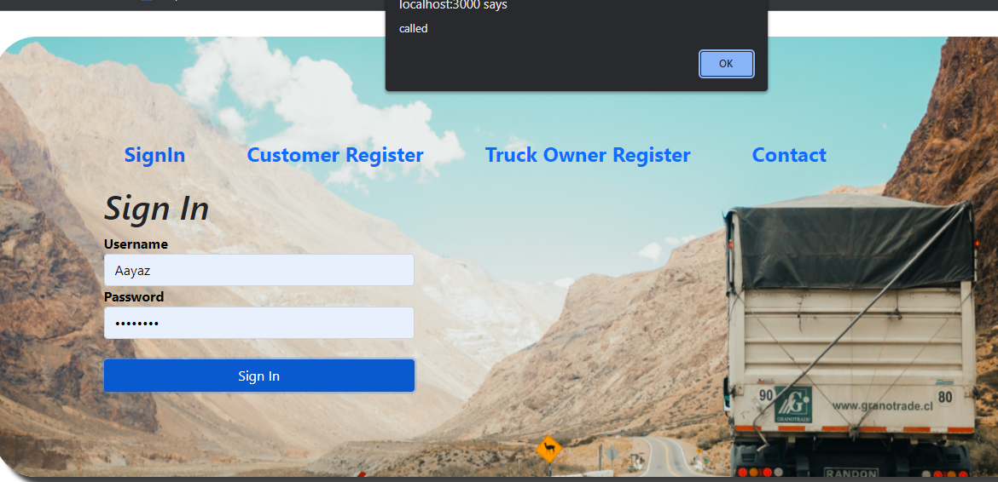

Slide 30
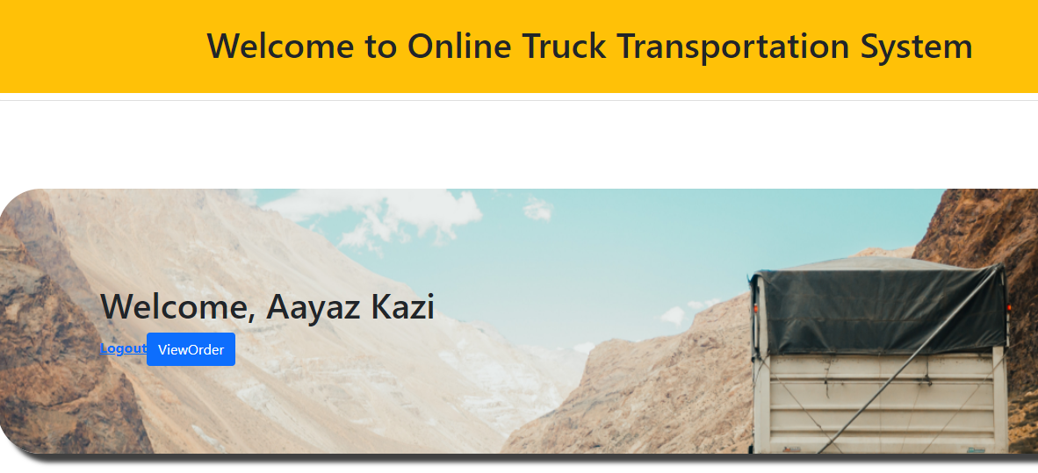

Slide 31
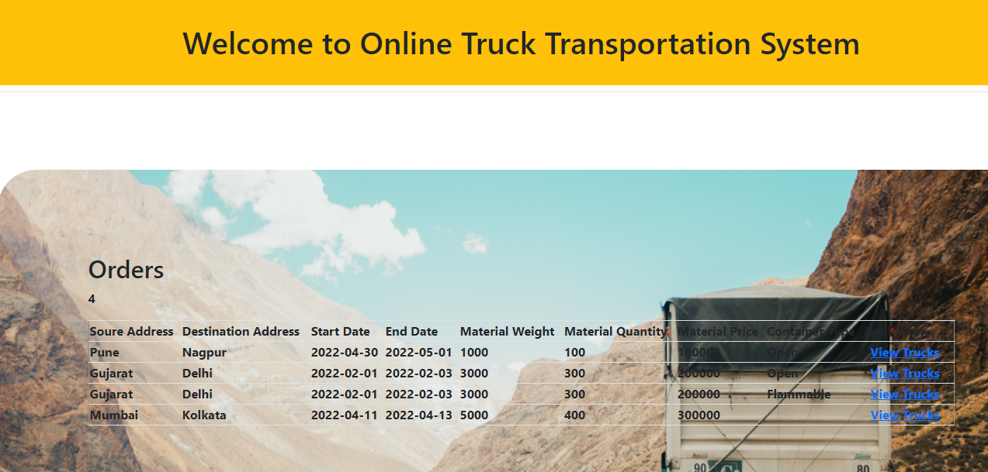

Slide 32
Future Scope
In future this system can also be added with additional feature like Online Payment Gateway, Online Transportation Booking and online tracking of vehicles.

Slide 33
Conclusion
The development of the proposed system provides a smoother, faster, less ambiguous and novice friendly platform to handle the operations involved in the booking system for the users on both the end along with the security and the status of the goods being transported.
By the introduction of this kind of system its accessibility will become a boon to both the users to interact and settle deals with a faster medium and by eliminating the usage of traditional phone directory and the dependency on contacts to respond in time during urgencies. Thus, by using this technology the platform can connect the brokers as well as the manufacturers all over the world.

Slide 34
Thank You

